Slide 1
Energy and Transfer
No quiero vivir mas

Slide 2
What is energy?

Slide 3
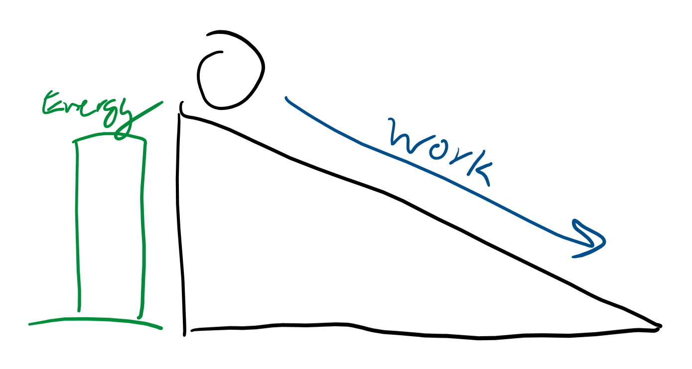
Energy is the ability to do work
If you’ve had a class with me, you’ve probably heard this a million times
It takes energy for you to get up in the morning
It takes energy to lift a box
Why does breaking bonds also count as work?

Slide 4
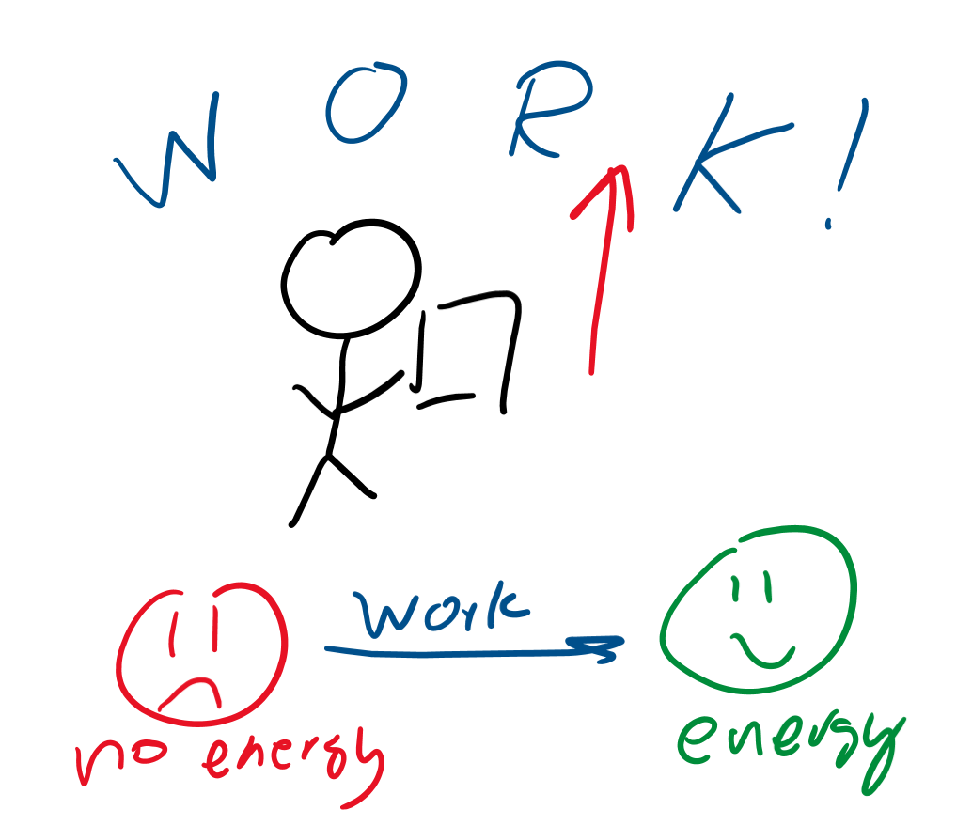
Ways to raise energy
Do work on something:
Lifting a box gives it energy
Kicking a ball gives it energy
Why would breaking bonds increase energy?

Slide 5
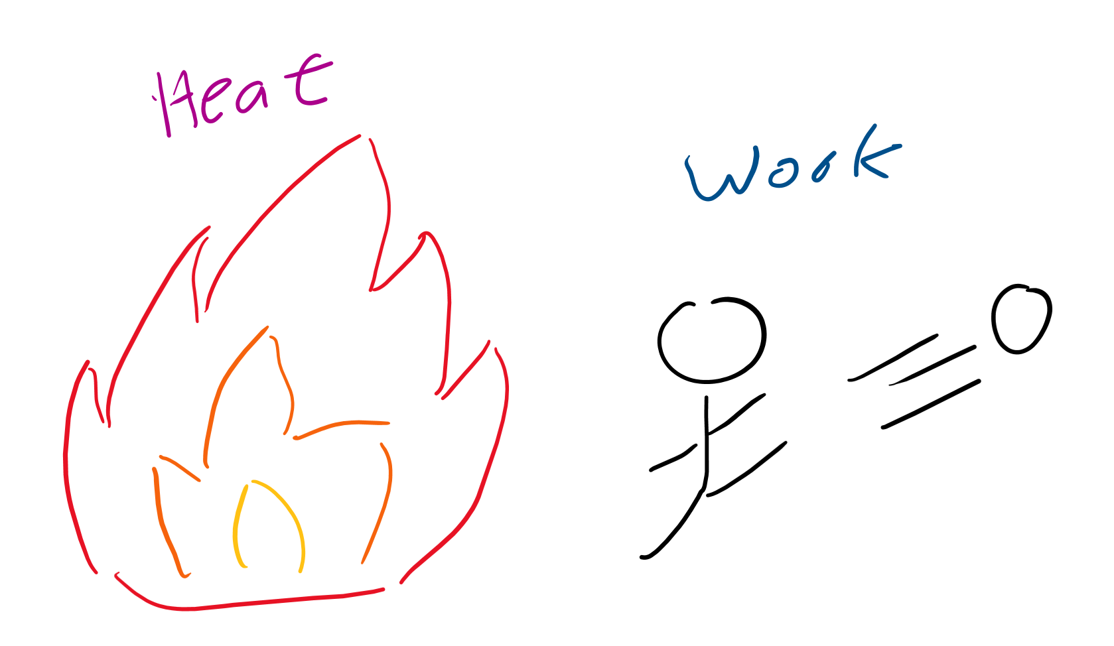
Energy in Thermodynamics
Two ways energy is transferred
Heat (a form of energy)
Work

Slide 6
Heat

Slide 7
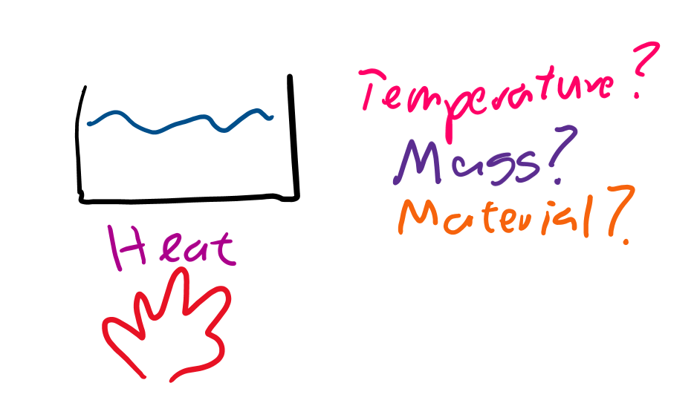
Heat-Temperature relationship
Three questions?
If you heat something up, what do you expect to happen to the temperature?
Would more massive things (a large pot of spaghetti water) or less massive things (a small glass of green tea) heat up faster?
Does the material you’re heating up affect how much it’s heated?

Slide 8
Answers
Temperature should raise!
More massive means it heats up slower because there’s more stuff to heat up.
Some materials, like air, can heat up super quickly while things like water heat up slower.
Because water heats up slower, it’s colder near a coastline because you’re closer to it

Slide 9
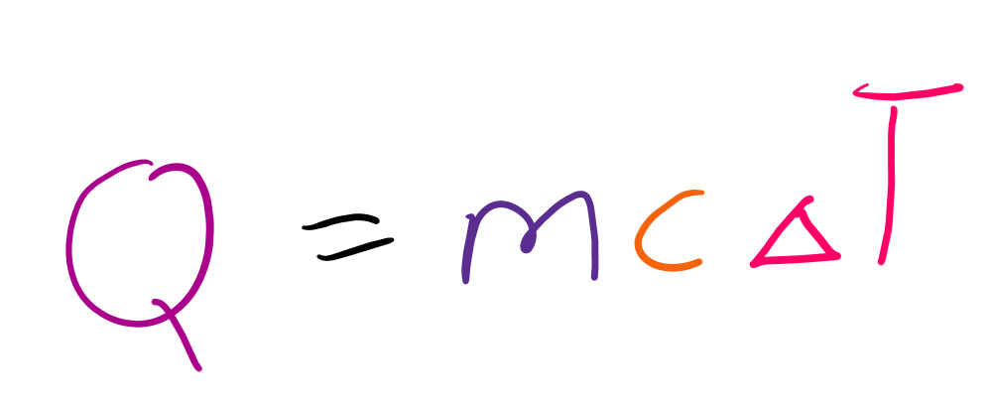
Spooky time, equation time
Q is heat (as you can see the word heat clearly starts with Q, so very easy to remember)
m is mass
c is specific heat capacity, which just represents how much an object resists temperature change
ΔT is the change in temperature
If anything on the right is bigger, more heat is needed

Slide 10
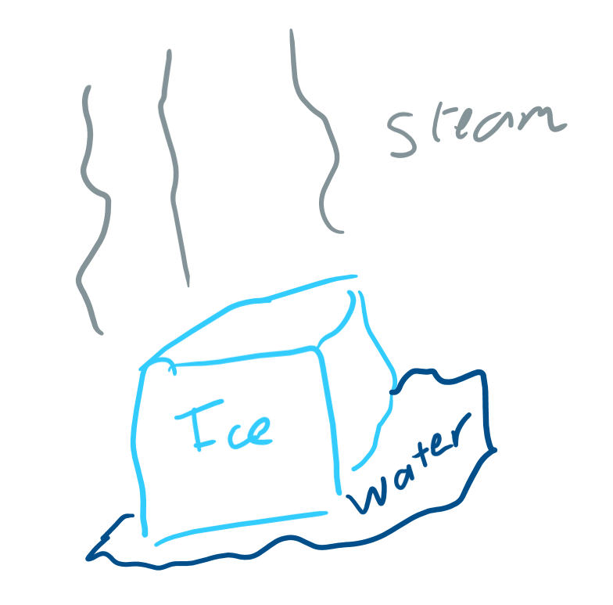
Phases
What are the phases of matter?
(Just the three main ones)

Slide 11
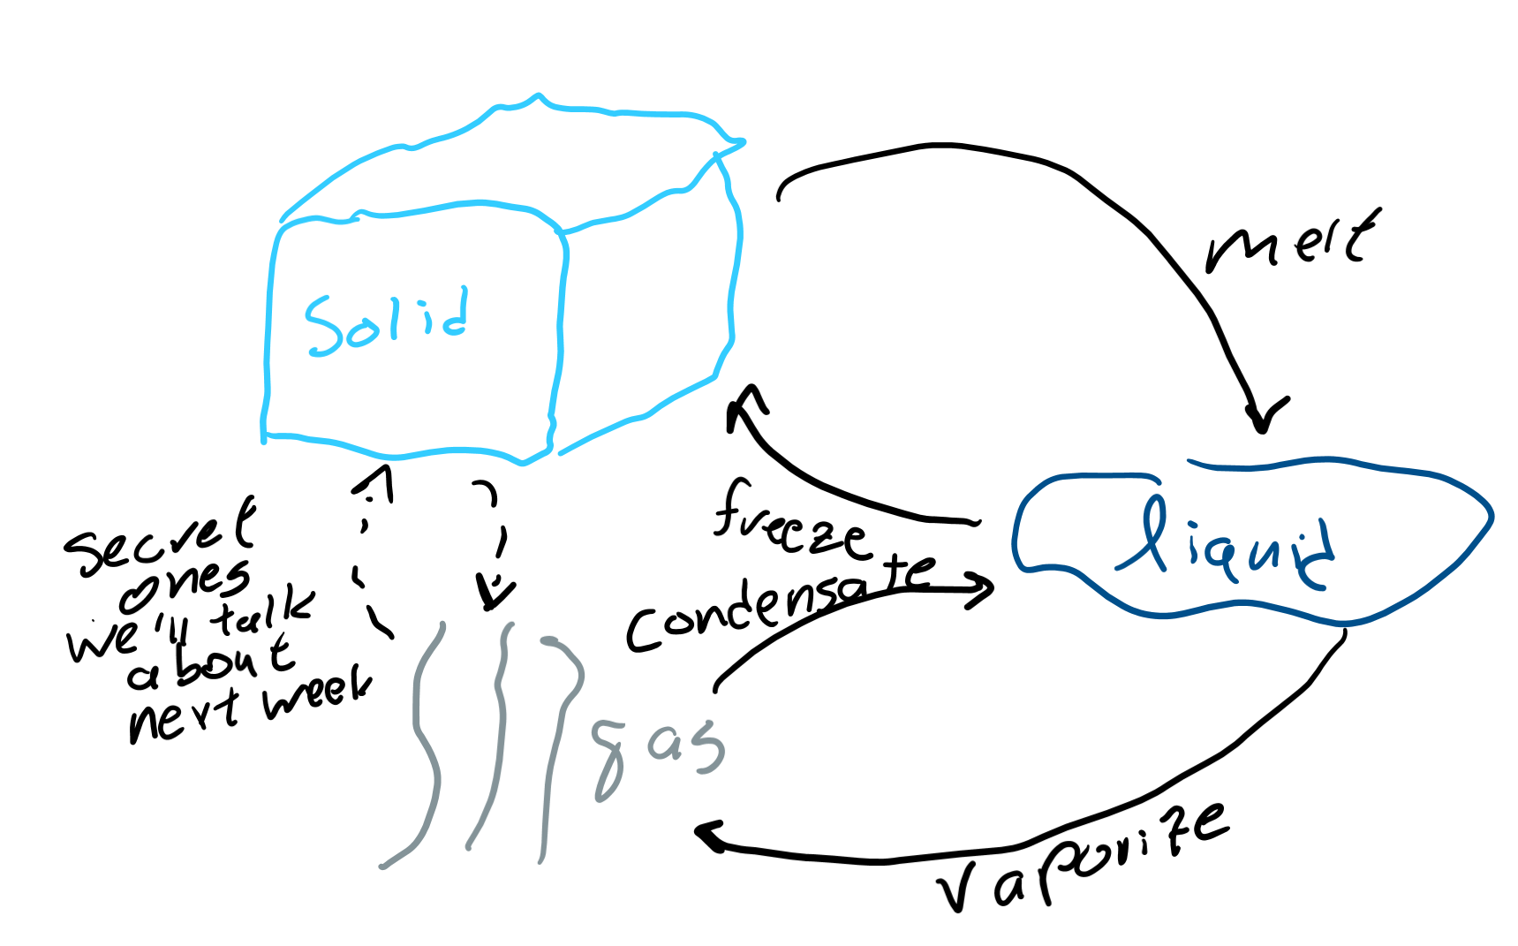
Phase changes

Slide 12
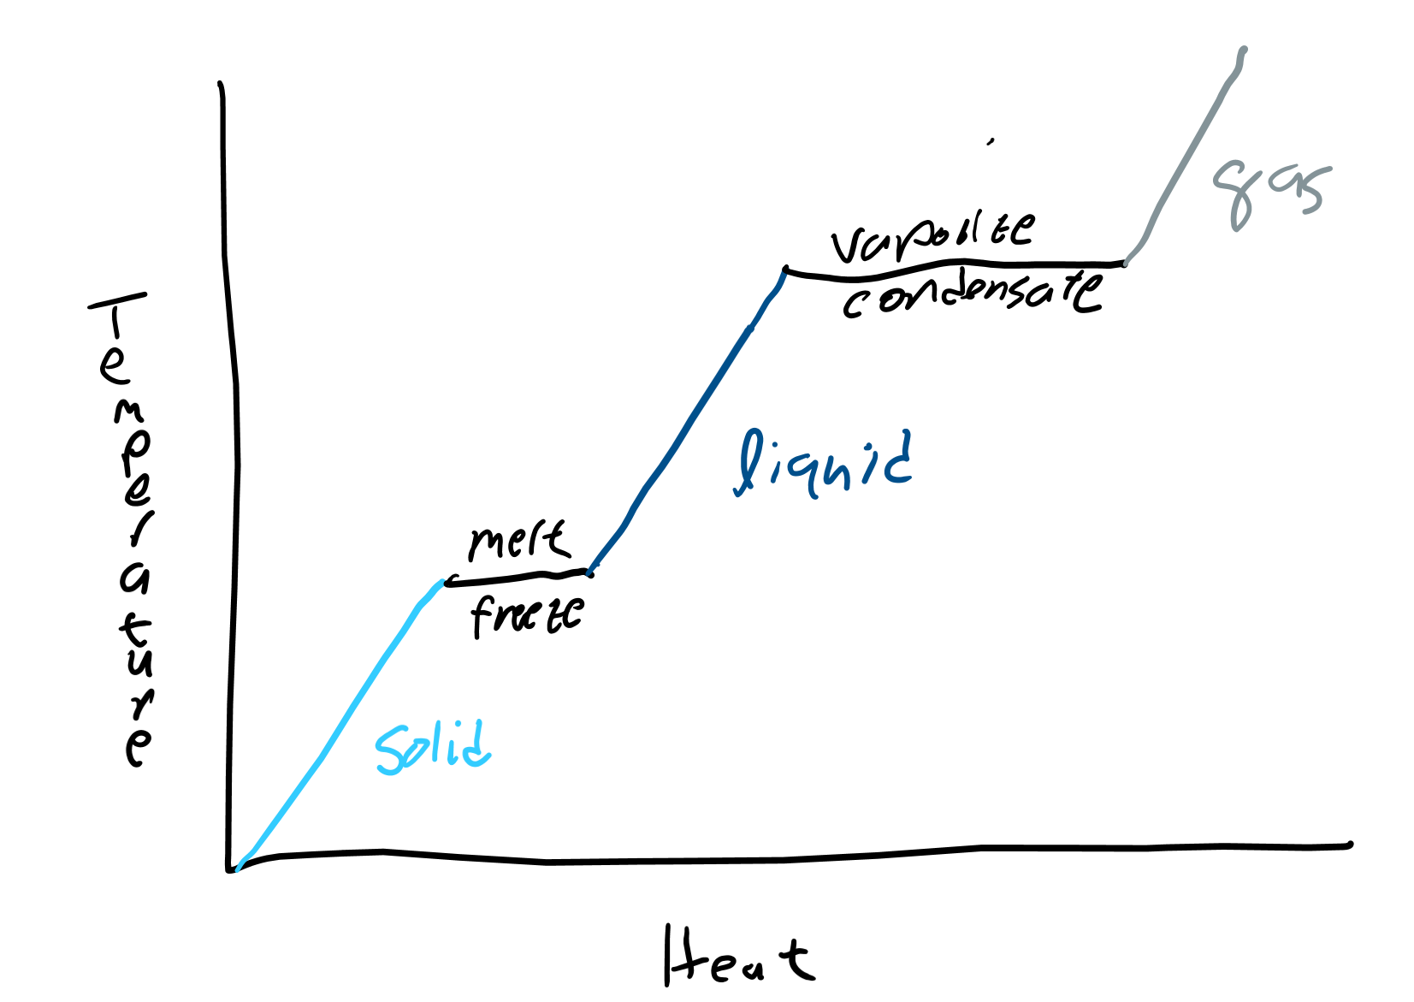
Phase change diagrams
When substances change from one phase to another, temperature does not change
Thus, if you heat ice up, it’ll get warmer and warmer until it hits 0 degrees Celsius where it melts, and then

Slide 13
Work

Slide 14
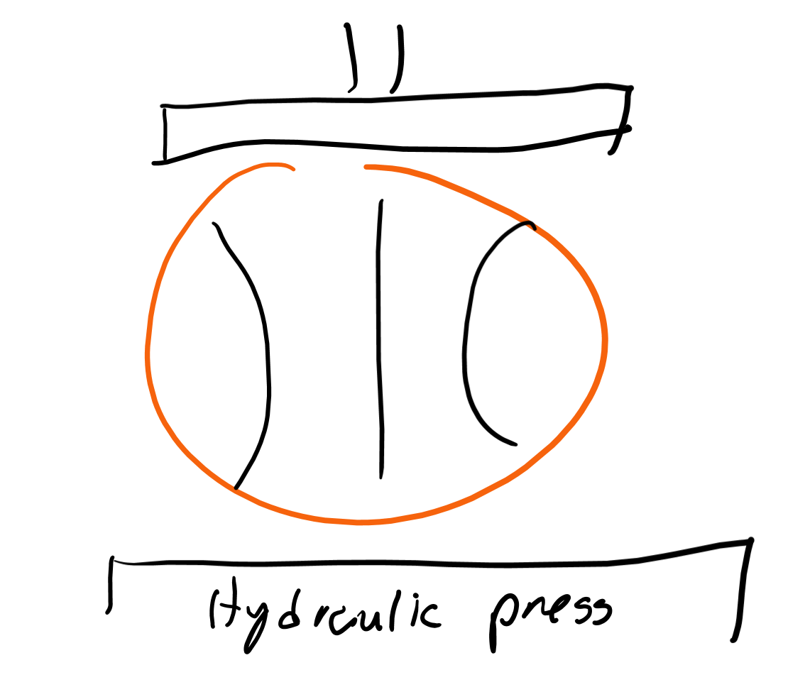
How to work
If you squeeze a ball, what’re you doing on it? (Hint: the answer is work)
If you do work on the ball, how will this affect the energy of the ball?

Slide 15
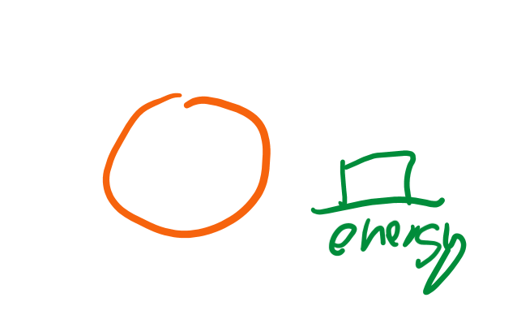
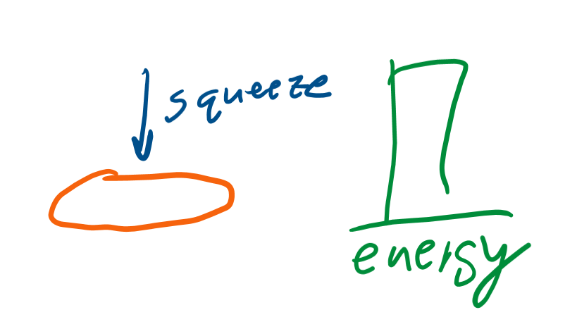
Work in thermodynamics
One of the only ways to do work is the squeeze things.
What happens to the volume of the ball when you squeeze it?
But what happened to the energy?
If volume goes down, what should happen to energy?

Slide 16
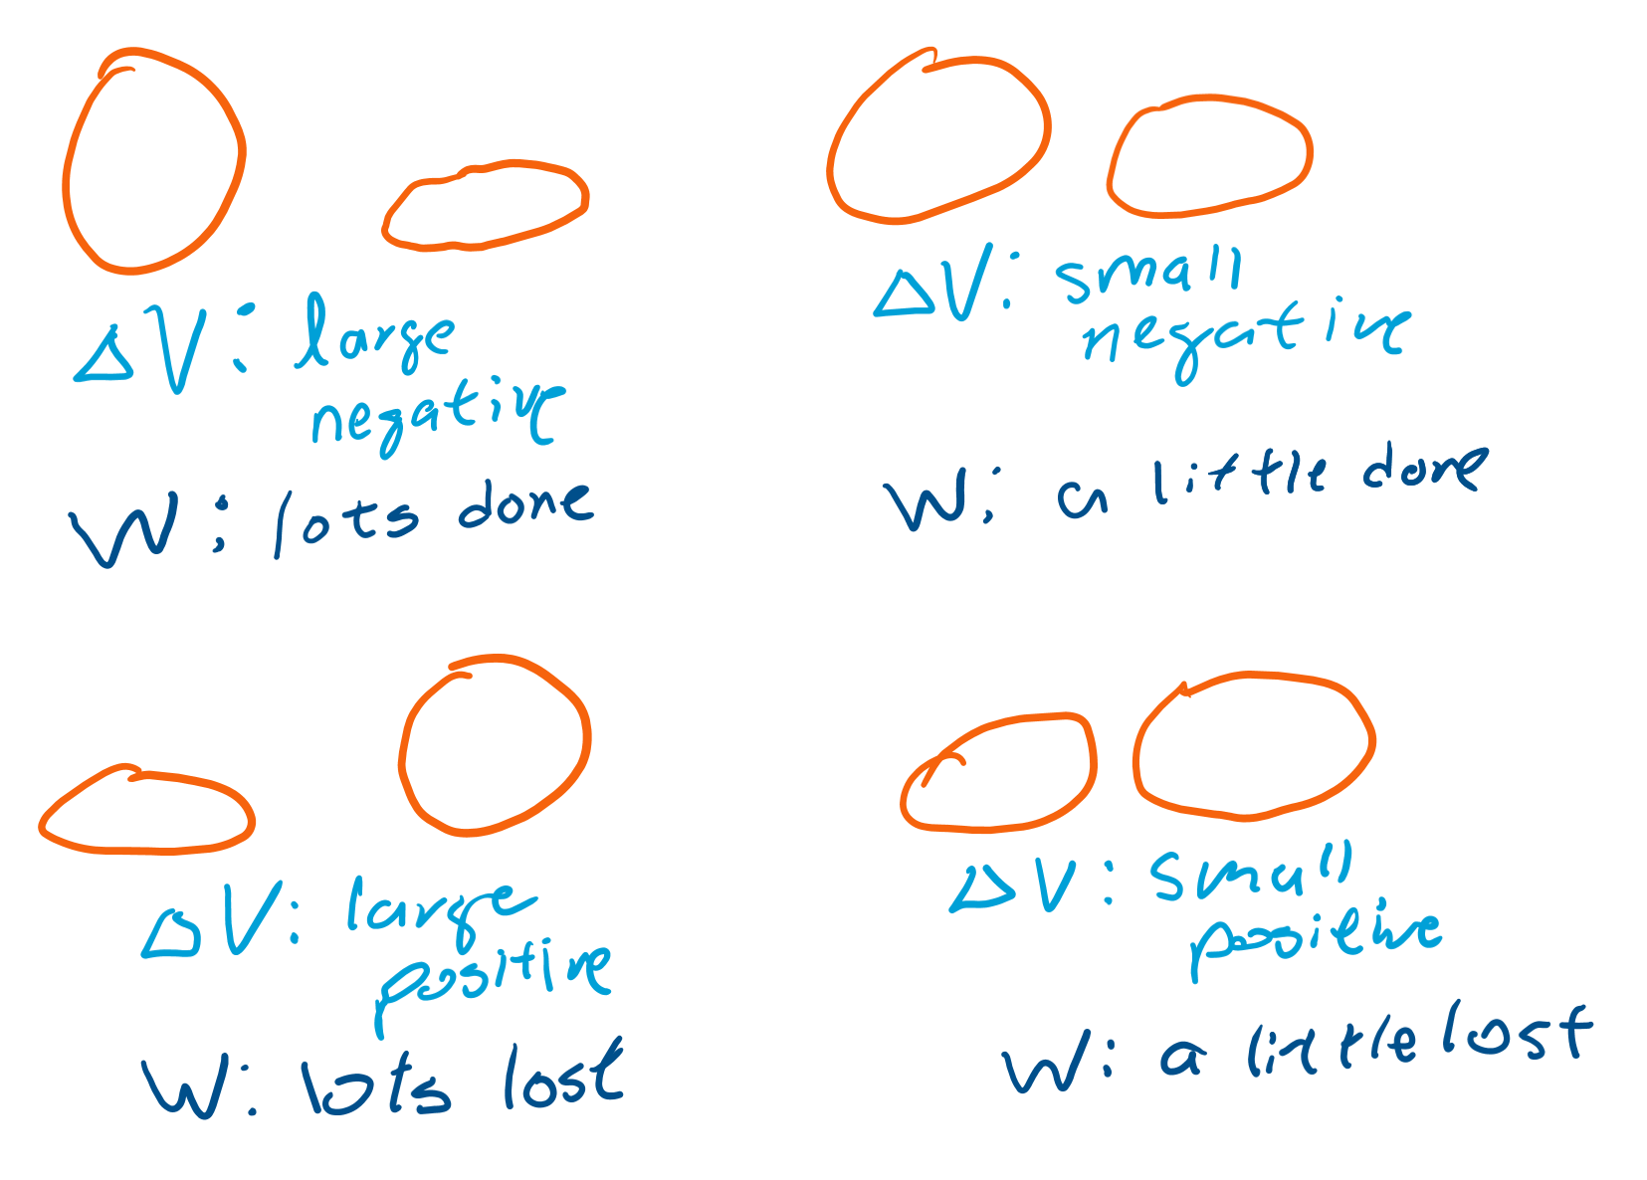
Change in volume
ΔV is change in volume
If change in volume is higher, more work is done, but only if we squeeze the ball
If the ball pushes on us, the gasses inside are doing work on us (they’re pushing us)
So ΔV has to be negative for us to do work on the system

Slide 17
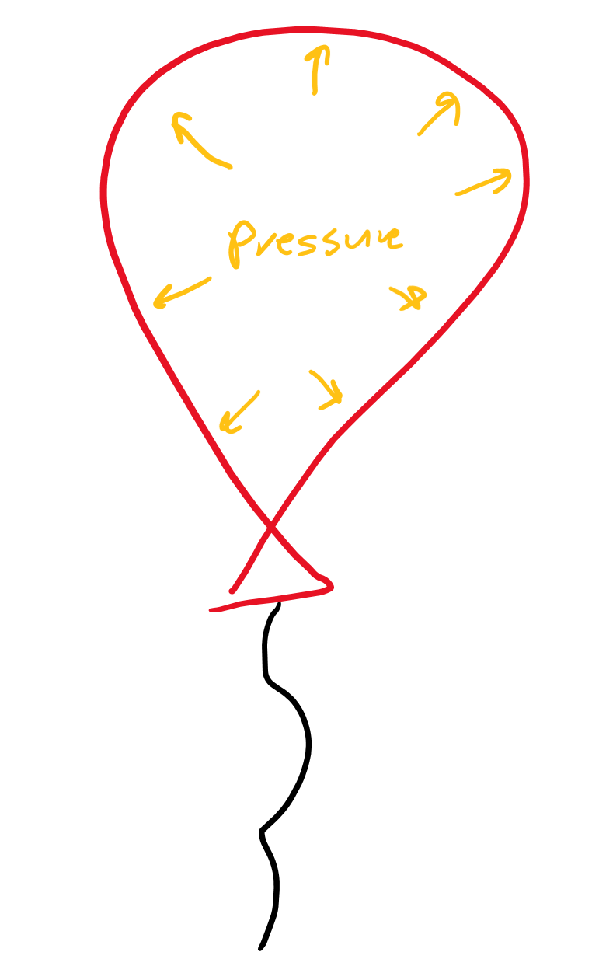
Pressure
Pressure is how much the gasses are pushing against you.
Is it harder to squeeze a deflated tire (one with low pressure) or an inflated tire (one with high pressure)?
If you squeeze harder, are you doing more or less work?
If pressure is higher, what does that mean about work done during squeezing?

Slide 18
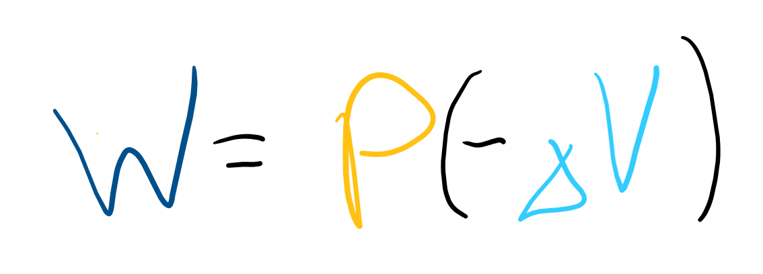
Equation
W is work (hard to remember because work doesn’t start with W)
P is pressure, notice how if pressure is a bigger number, work is a bigger number
ΔV is change in volume

Slide 19
Combined?

Slide 20
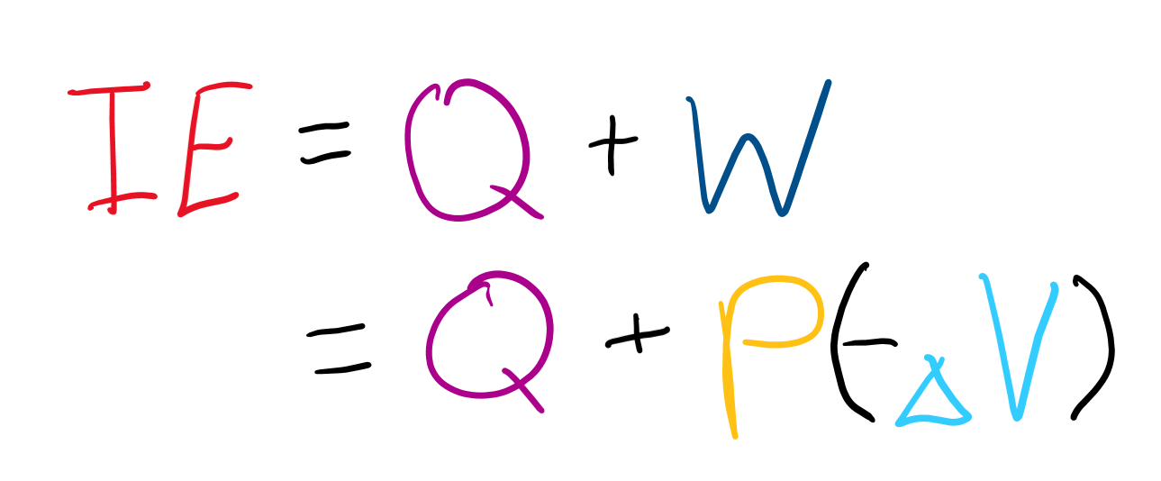
Equation!
IE is internal energy (the energy inside the system)
All we do is add heat and work!

